Slide 1
Latvia
Correspondence School of Jelgava Local Municipality
Youth Council

Slide 2
Taking part in Youth Council is voluntary work that takes place after the students own initiative in their free time.

Slide 3
Youth Council Structure:
One or two representatives from each class
The President of the Youth Council
The Teacher-Coordinator

Slide 4
Youth Council meets together before lessons. If it is necessary the meeting is two times per week and even at holidays.

Slide 5
The Aims of Youth Council
Aligning the interests of students and administration,
Active involvement in learning,in organizing sports and community work,
Creating a positive learning environment.

Slide 6
The Objectives of Youth Council
To cooperate with the school administration and teachers;
To represent students` interests to school administration and teachers;
To collect proposals and to try to implement them in educational institutions;
To cooperate with the school district`s self-government,local government and state institutions,as well as with other social organizations;
To take all possible measures to enhance the popularity of Correspondence School of Jelgava Local Municipality;
To organize cultural work at school.

Slide 7
Youth Council Activities
Students are regularly informed about important information or events:
-school activities,
-changes in various documents,laws,
-urgent information.

Slide 8
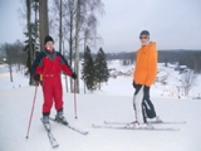
Promoting and engaging the rest of classmates in after school activities
Excursions and
a trip to ski resort resort

Slide 9
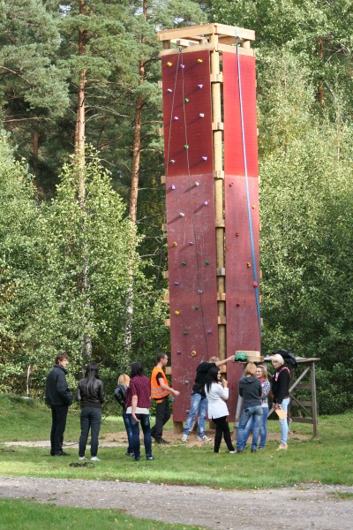
Sports competitions

Slide 10
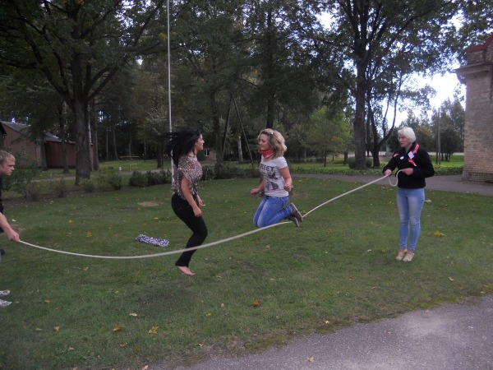

Slide 11
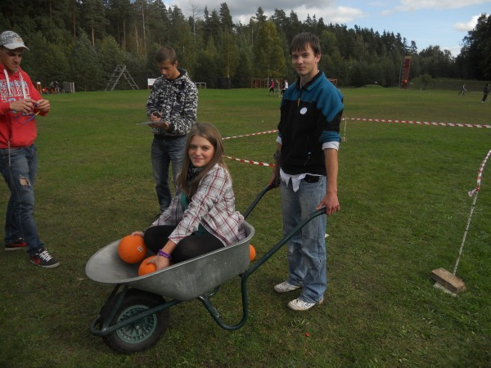

Slide 12
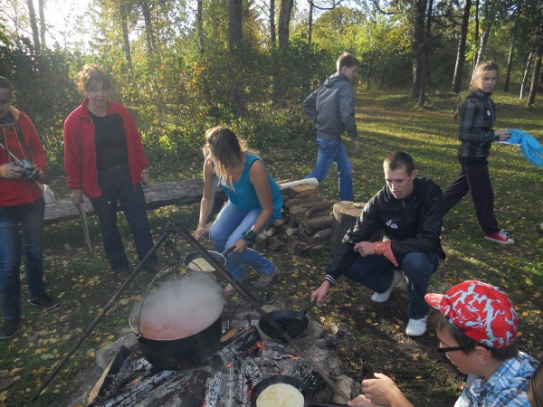

Slide 13
Charity events,
donating clothes to needy area families
Together we have collected 18 big bags (~250 kg) with clothes for kids, youth and adults.
April-goodness month

Slide 14
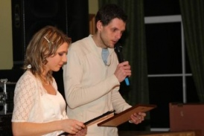
Local Council donation campaign ‘ Help!’ for children rehabilitation. Youth council`s President has written a poem for this event and it was a present for organizers.

Slide 15
District events and national events
(KNAB „No,corruption!”)
We have created a short video about corrupted policemen, doctors and politicians.

Slide 16
Courses and Seminars
Business-school training seminar for new businessmen/businesswomen
Experience sharing workshops with other young people in school self-governments

Slide 17
Doing the Surveys
For students (taking) nominations
„Teacher who inspires”
„Best Teacher”
Making Videos

Slide 18
Organizing school events
„Teacher`s day” celebration and greetings
We greeted our teachers with flowers and sweets
2. New Year event
3. Cooperative events with other consultation places like „Maslenica”celebration

Slide 19
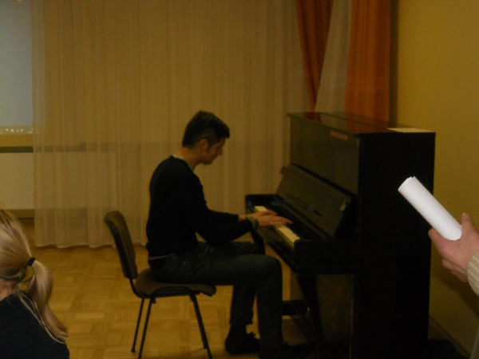
New Year event
Popular artist from Latvia has taken part
in this event.He studies in
our school and has been seen in a reality show.

Slide 20
New Year event
We sang KARAOKE together
Watched our made video ‘ The Year of Dragon’ and horoscopes
Assessed the exhibition of teachers hobbies
Played games

Slide 21
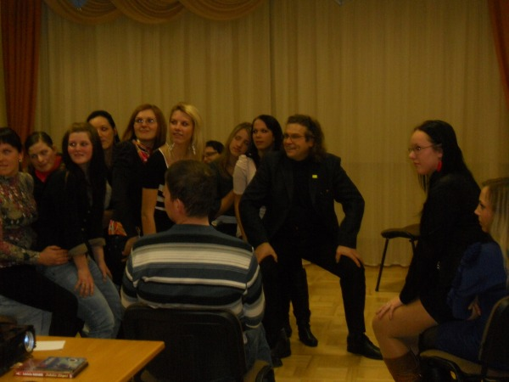

Slide 22
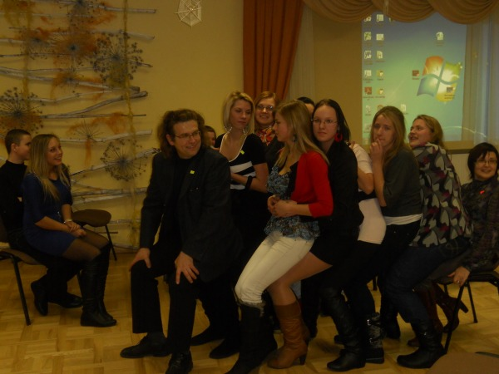

Slide 23
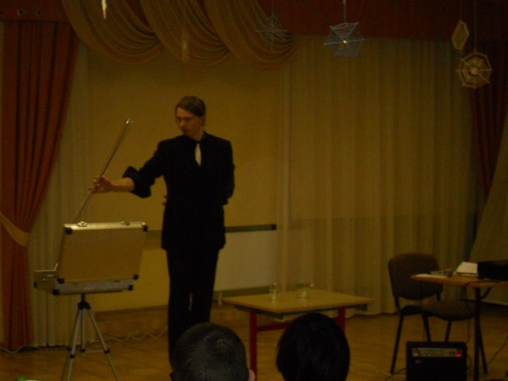
New Year event
Invited the magician- illusionist.
Everybody liked !!!!

Slide 24
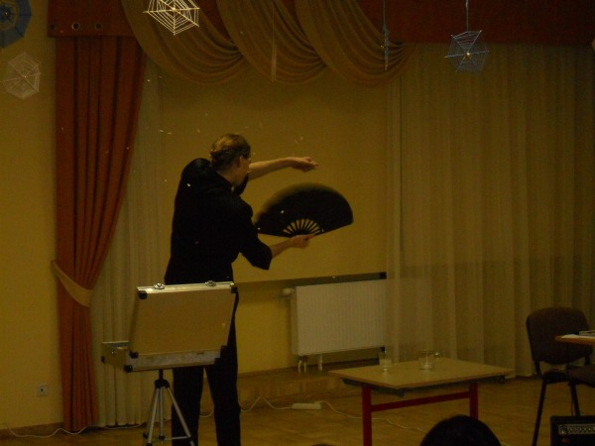

Slide 25
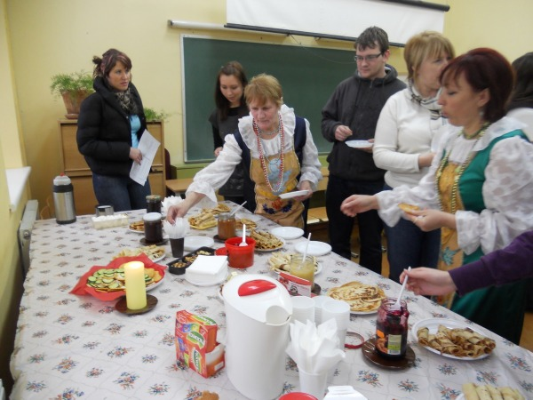
Cooperative events with other consultation places like „Maslenica”celebration - Russian traditional
celebrations.

Slide 26
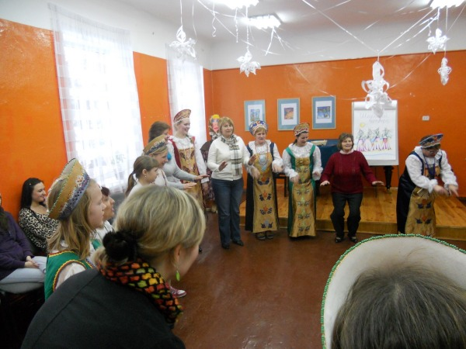

Slide 27
Taking part in Youth Council does not disturb the study process, it stimulates us to be more active in studies.

Slide 28
Thank You for Attention!!! ☺

